Slide 1

The Digital Epidemic
Supervisors:
Prof. Tom Montenegro-Johnson
Dr. Joe Webber
Presenters:
Anastasia Doan
Devavrate Verma
Nobel Nthebelong

Slide 2
Our Goals
We set out to model the adoption of new technology by:
Generating a network that models the structure and behaviour of human social networks.
Using epidemic models, create a new model that effectively simulates how technology spreads.
Run the model on our network and analyse the results using graph theory.

Slide 3

1. Introduction to SIR model

Slide 4
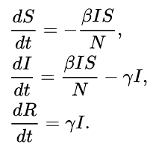
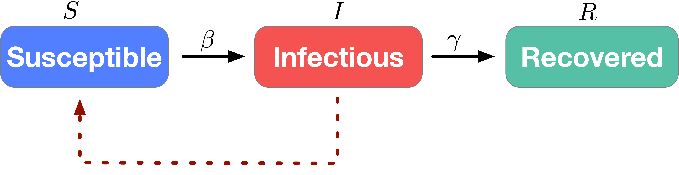
Deterministic SIR (susceptible, infected and recovered)
Limitations:
Constant population
A lot of assumptions, such as constant rates, homogeneous mixing, population uniformity

Slide 5
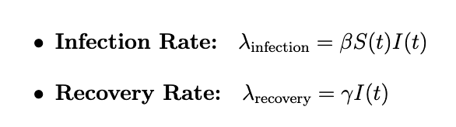
Deterministic SIR (susceptible, infected and recovered)
S(t)
I(t)
R(t)
Stochastic SIR
Limitations:
Constant population
A lot of assumptions, such as constant rates, homogeneous mixing, population uniformity
What’s new?!
Discrete-time
Randomness in distribution

Slide 6
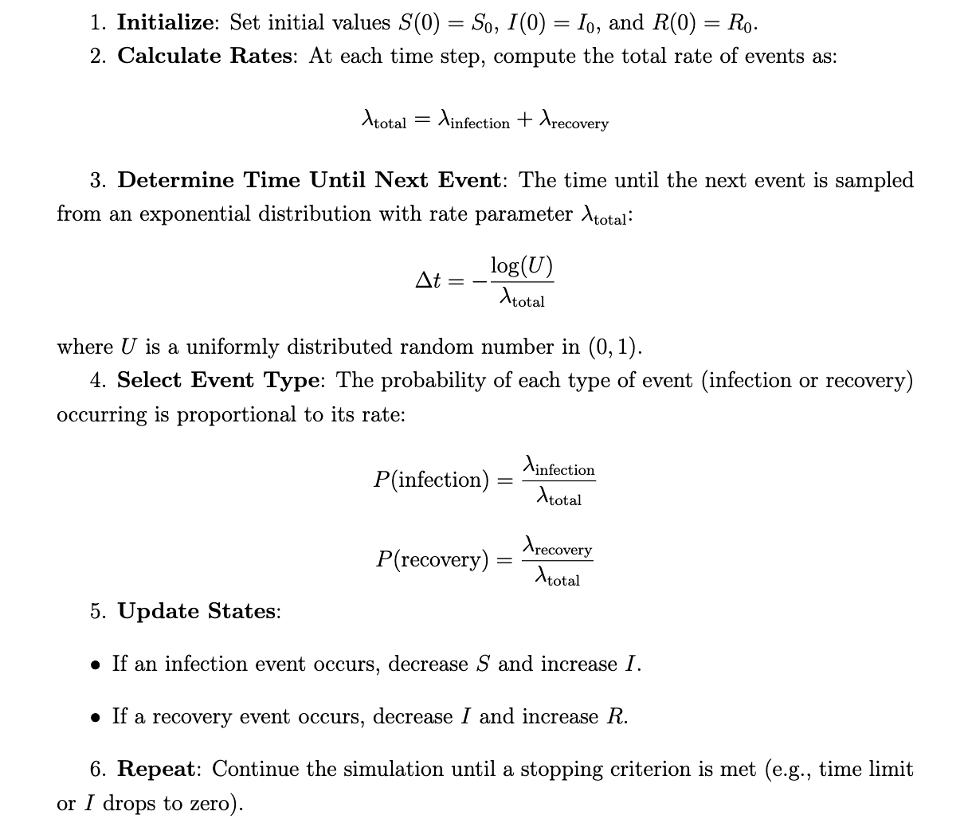
STEPS!

Slide 7
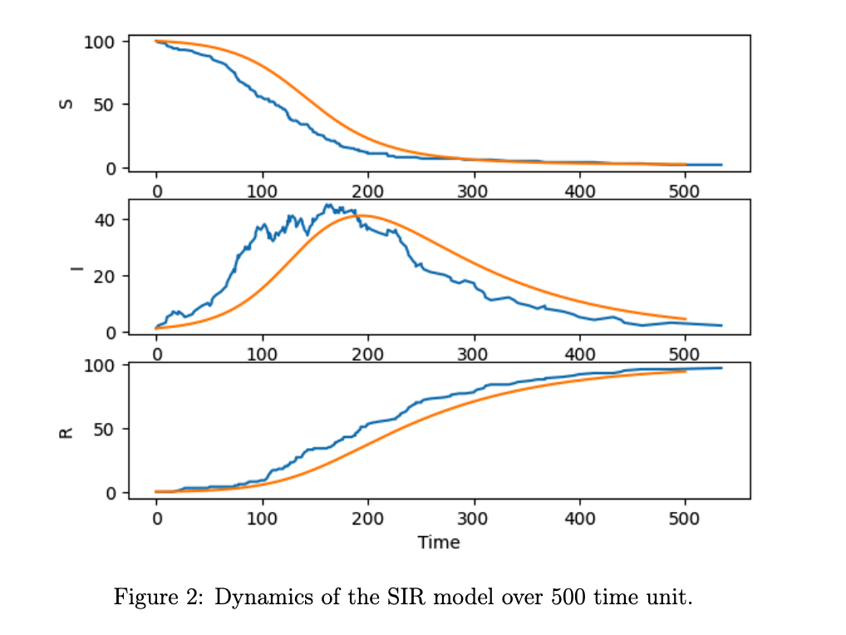
Comparison

Slide 8

2. Network and Network Centrality

Slide 9

Definitions
A walk of length k is a sequence of vertices/nodes and edges on a graph described as $v_{0}e_{0}…e_{k−1}v_{k}$.
A path is then defined as a walk with no repeated vertices. The length of a path on an unweighted graph is defined to be the number of edges in that path.
Let $u,v$be distinct vertices/nodes on the graph. Then define $d\left(u,v\right)$to be the shortest path between these two nodes. Note that d is a metric on this graph.
This distance is known as the geodesic distance between these two vertices/nodes also known as the $u−v$ geodesic in other literature.
The adjacency matrix A of a graph is the n x n matrix whose (i, j)-th entry is 1 if there exists an edge joining distinct vertices, and 0 otherwise.

Slide 10
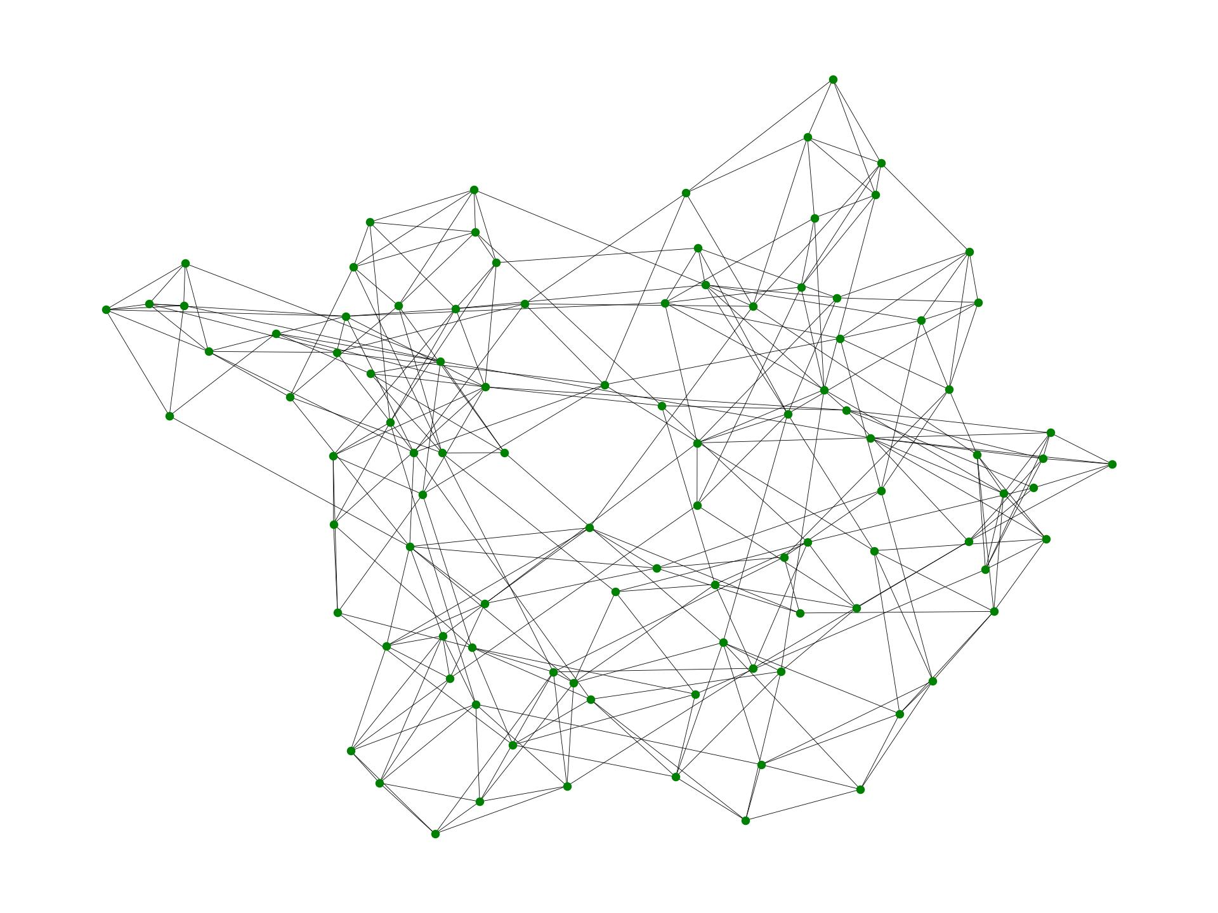
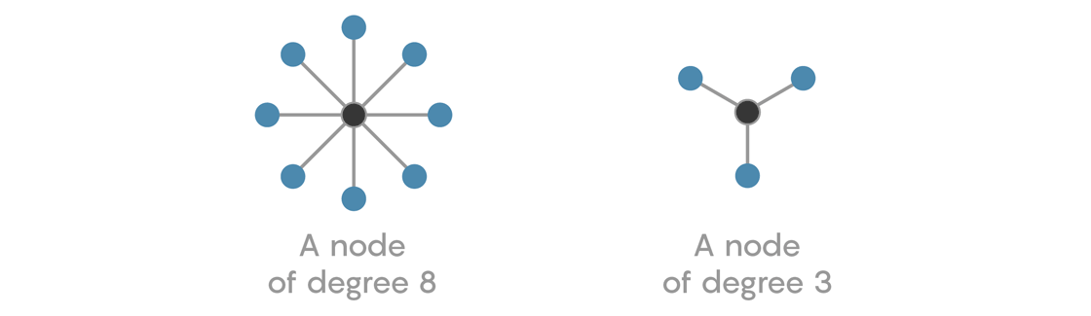
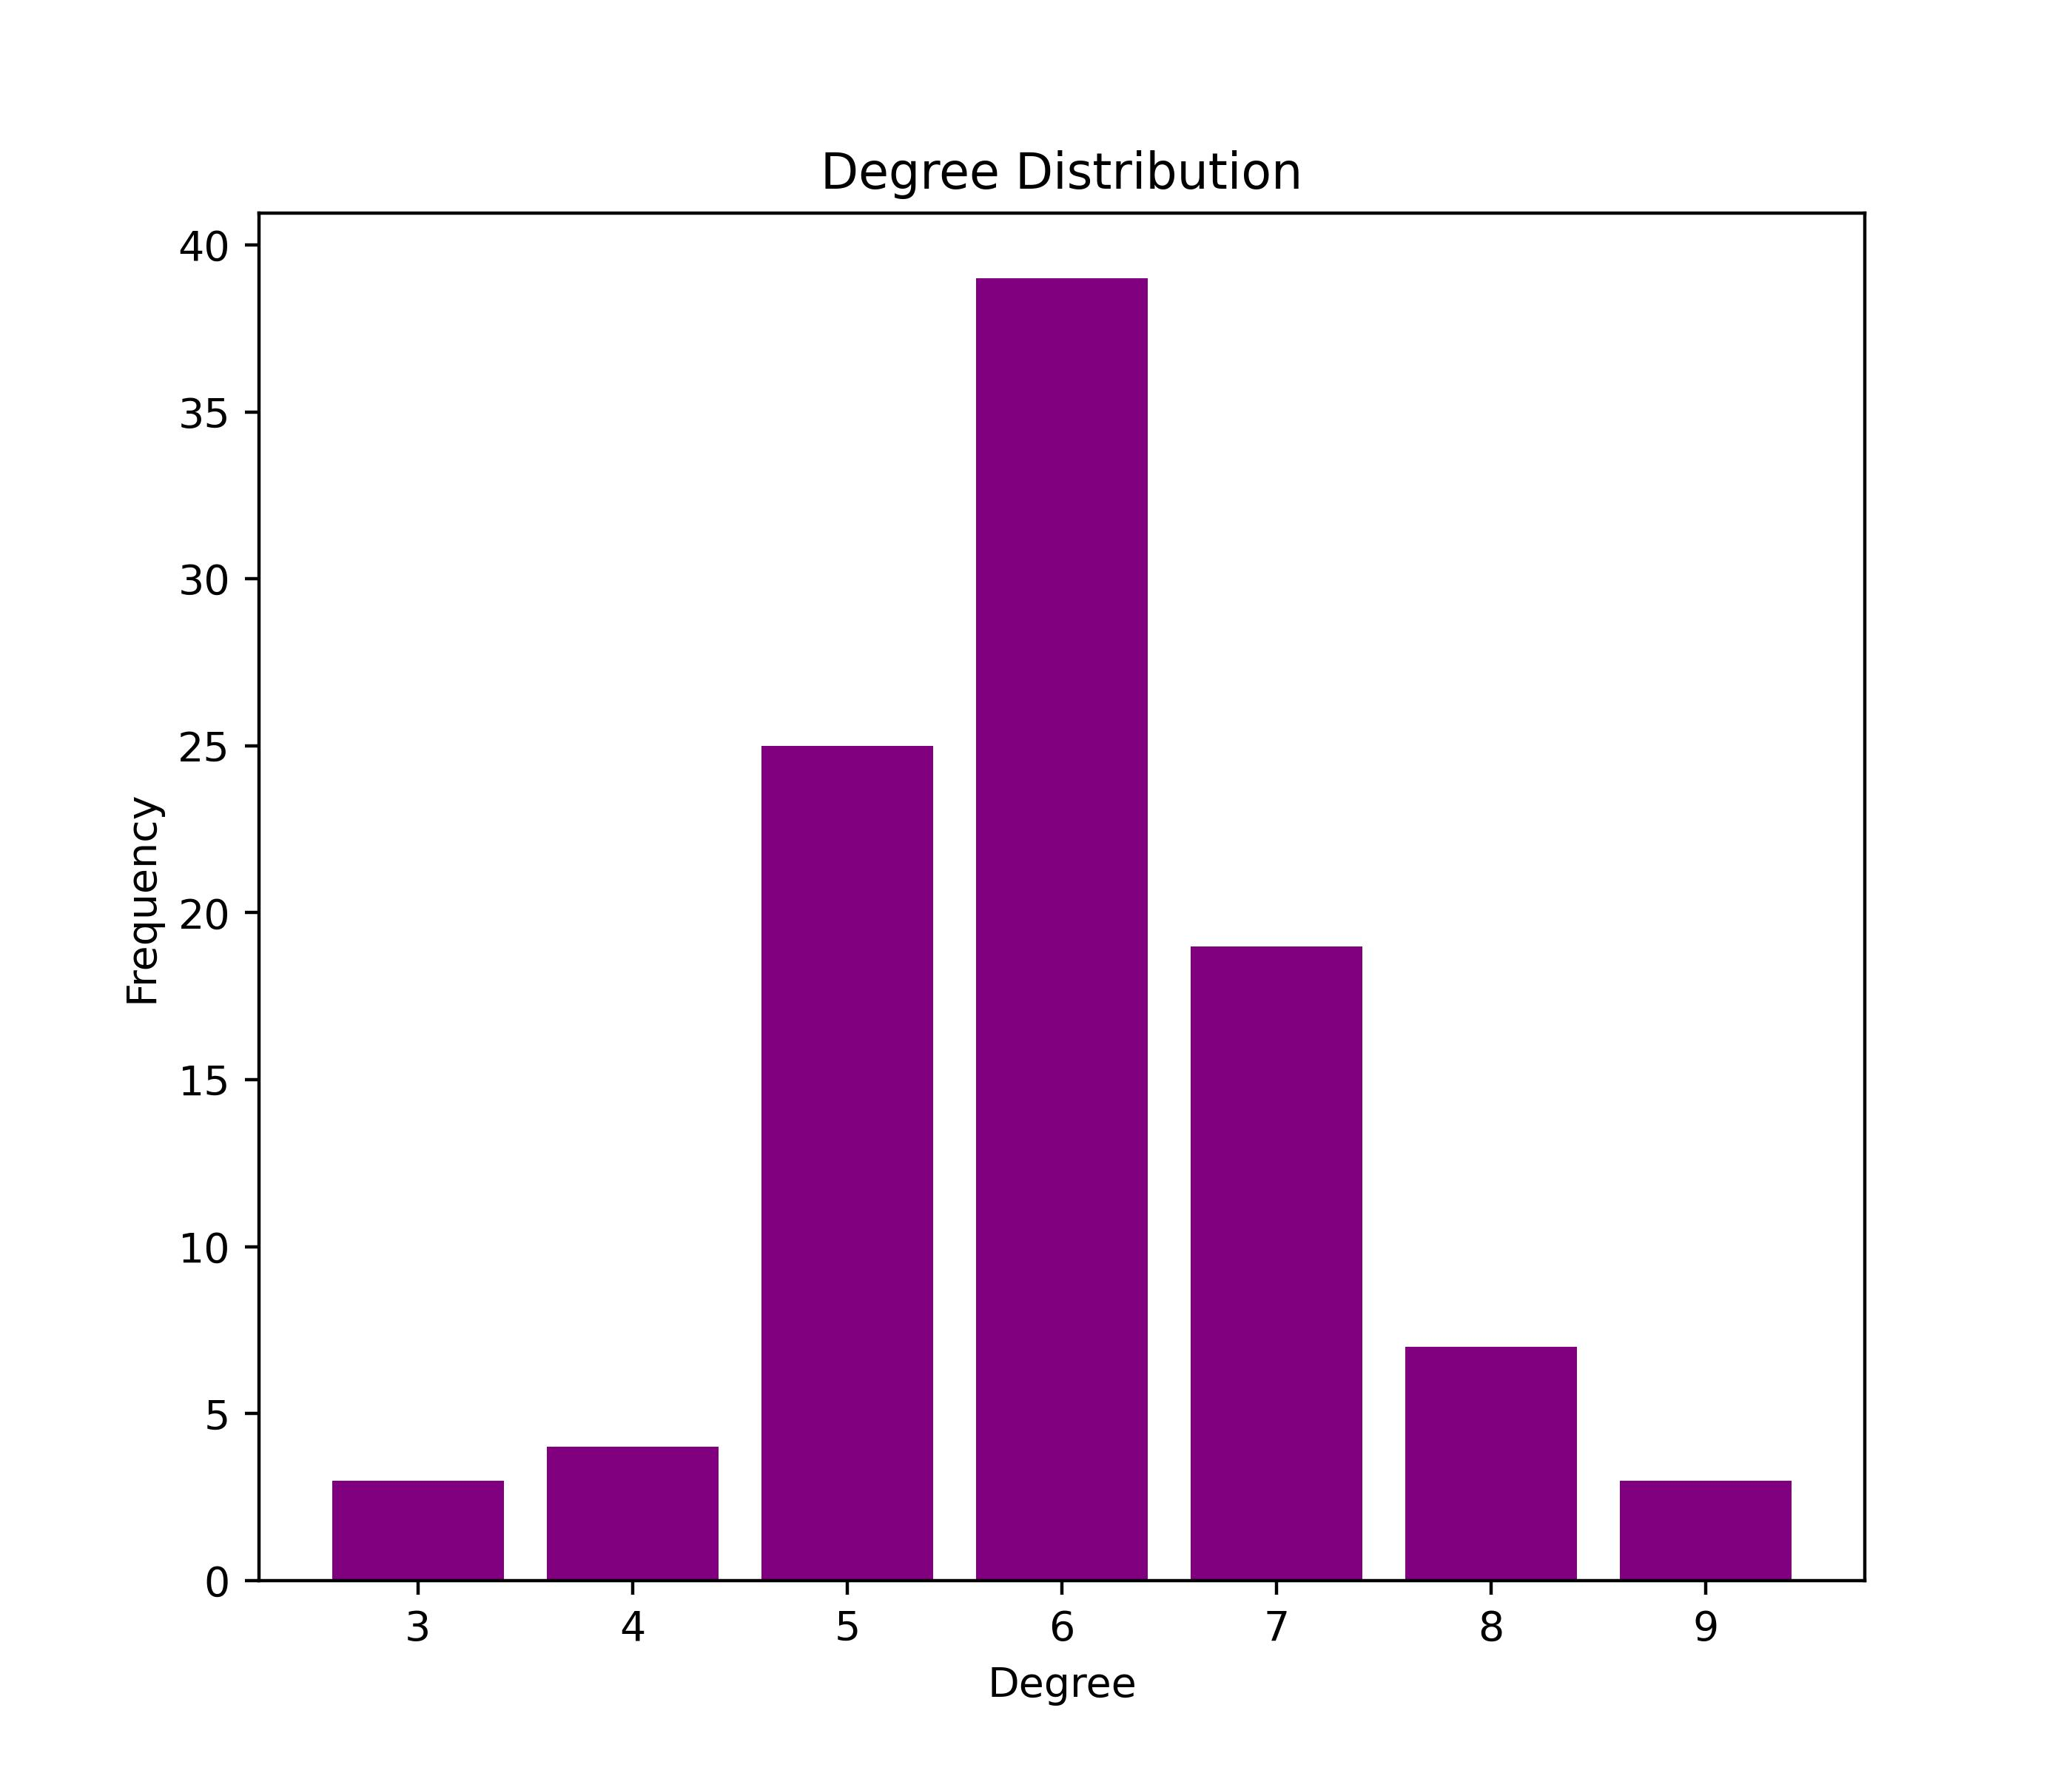
Node/Vertex Degree
The degree of a vertex/node is defined as the number of edges incident on that vertex/node.
Define p_{k} to be the fraction of vertices having degree k.
The degree distribution is then given by a plot of p_{k} , which is a histogram.

Slide 11
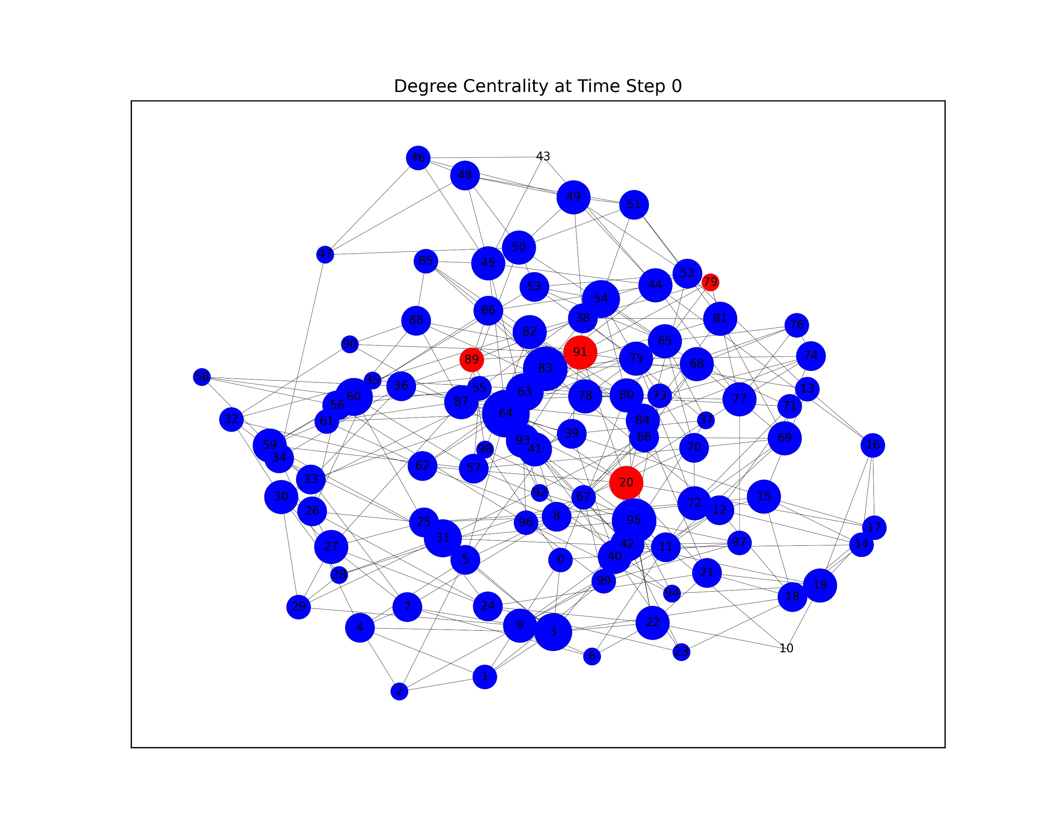
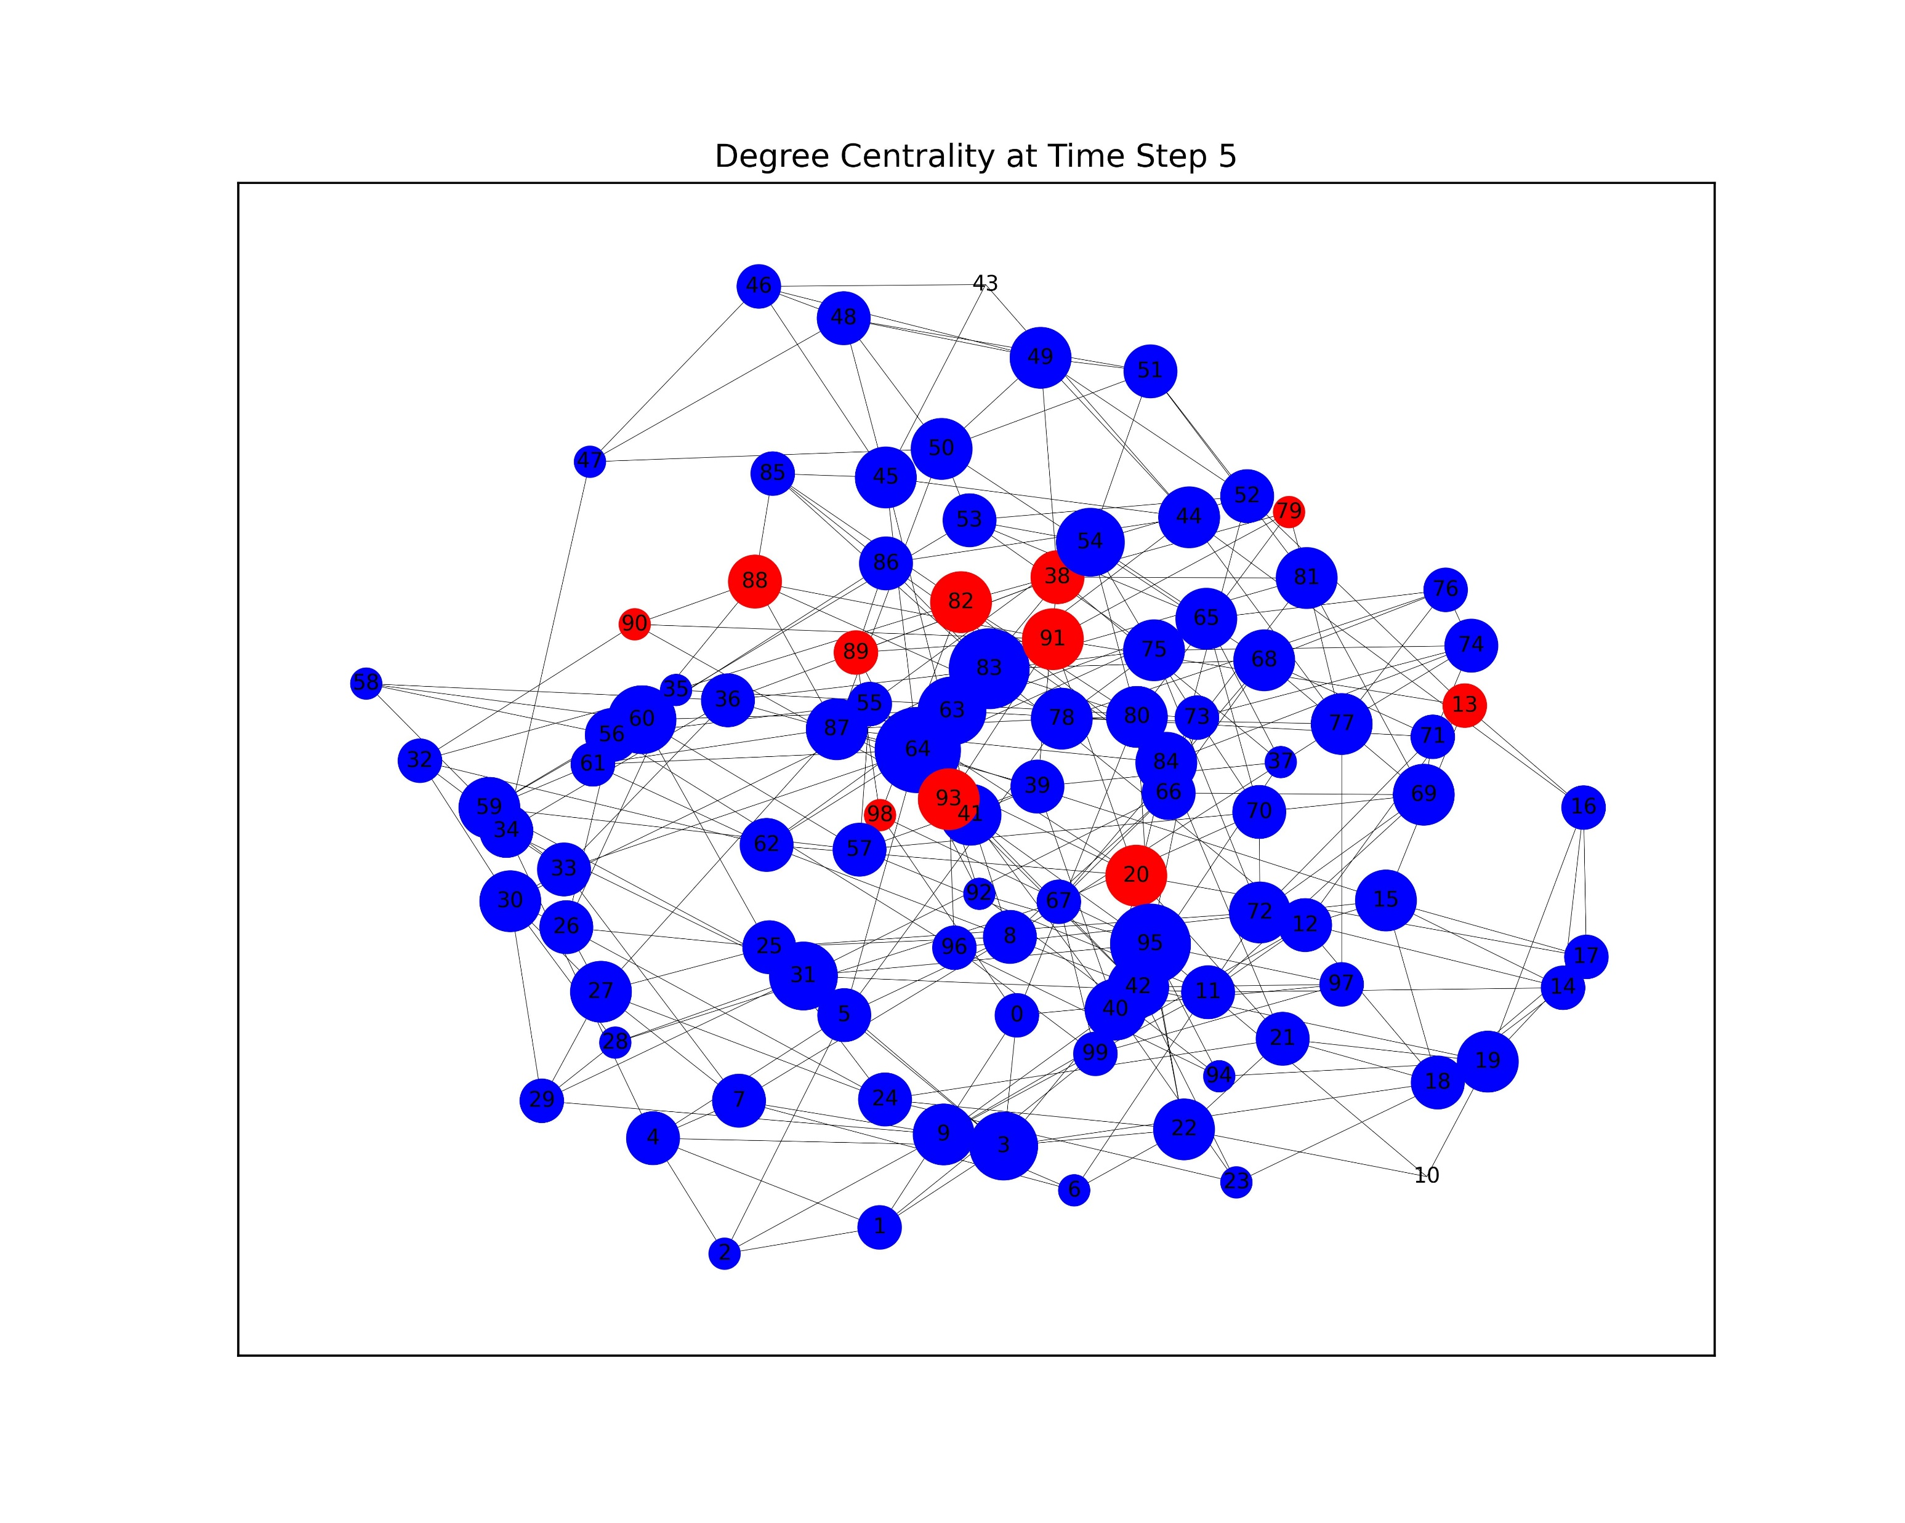

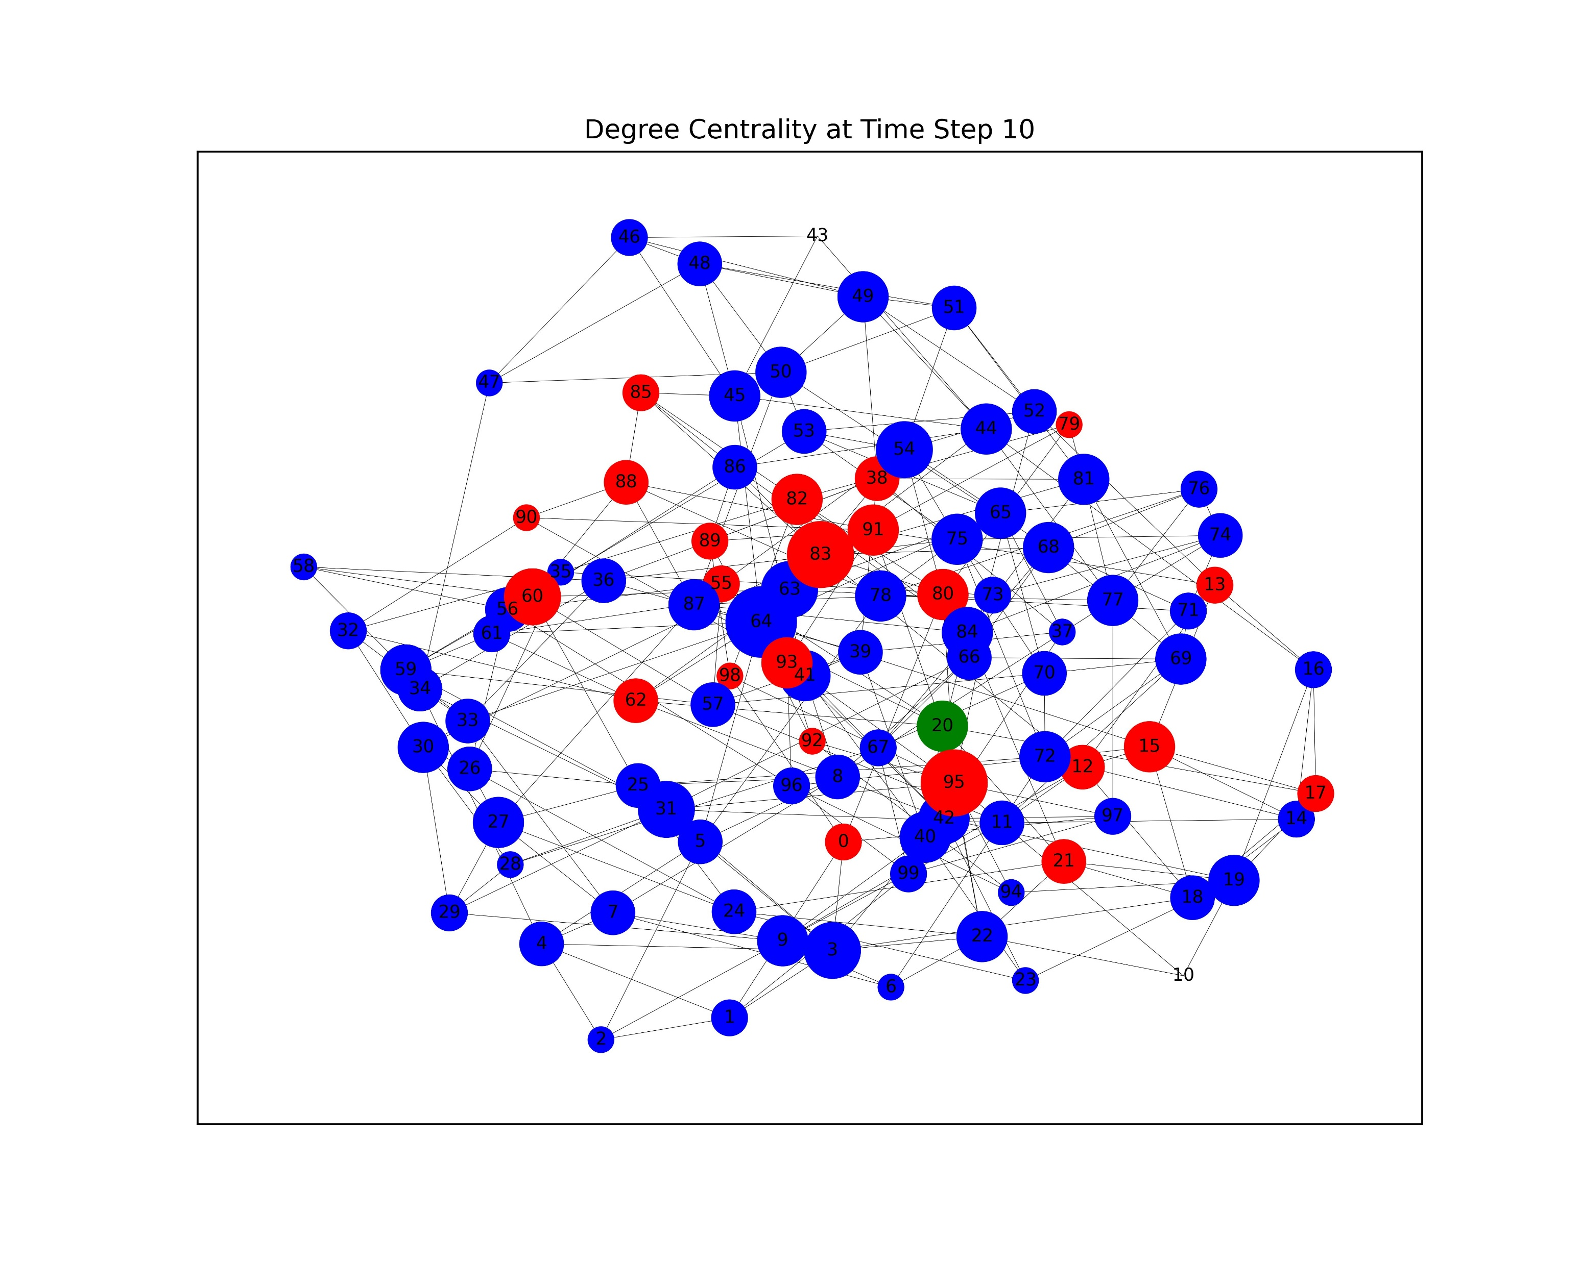
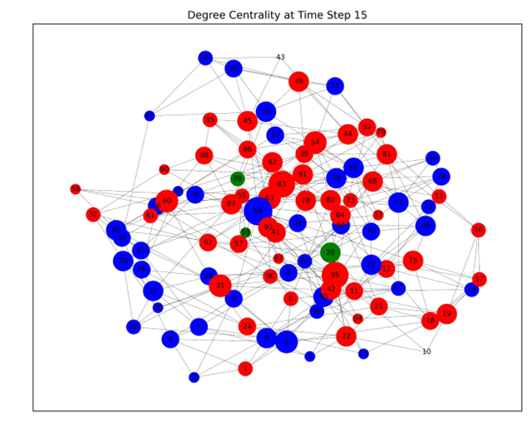

Point Centrality Measure
Degree Centrality: indicates how important a node is based on the degree it has. A node is therefore central if it has a high degree of centrality.
The degree centrality of a vertex/node v is given by the following equation,
$$C_{D}\left(v\right)=\frac{d_{v}}{n−1}$$
Where $d_{v}$ is the degree of that node.
The term n-1 is introduced to normalize the centrality measure.
Developed in the 1940s by social scientists to investigate social networks by identifying ‘central’ nodes among communication networks.
The ‘point’ referring to nodes and graph centrality which deals with the whole network.
Well-known centrality measures are:
degree centrality,
betweenness centrality,
closeness centrality,
eigenvector centrality.

Slide 12
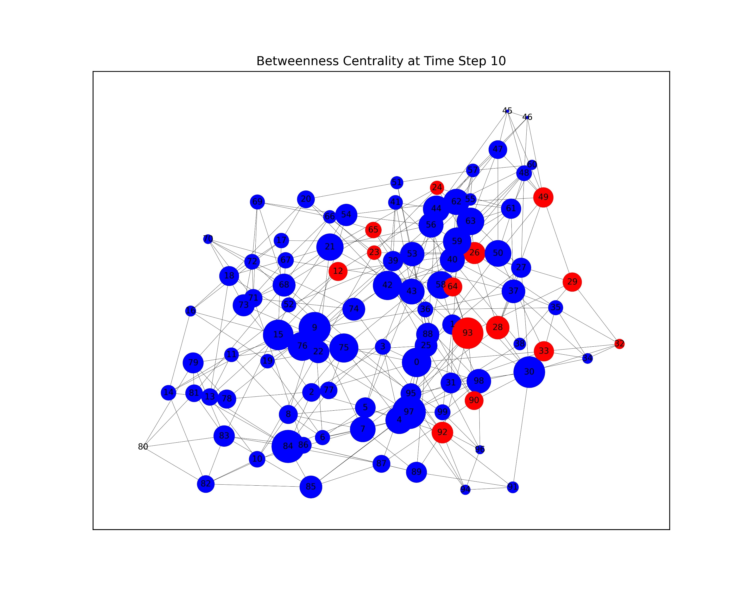
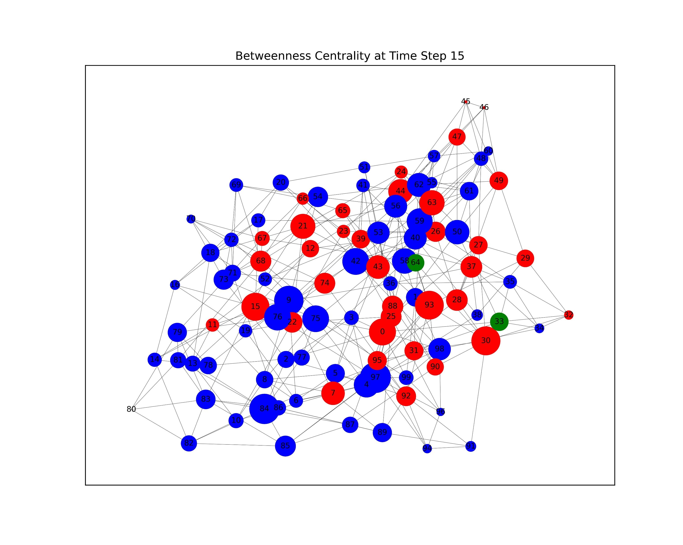
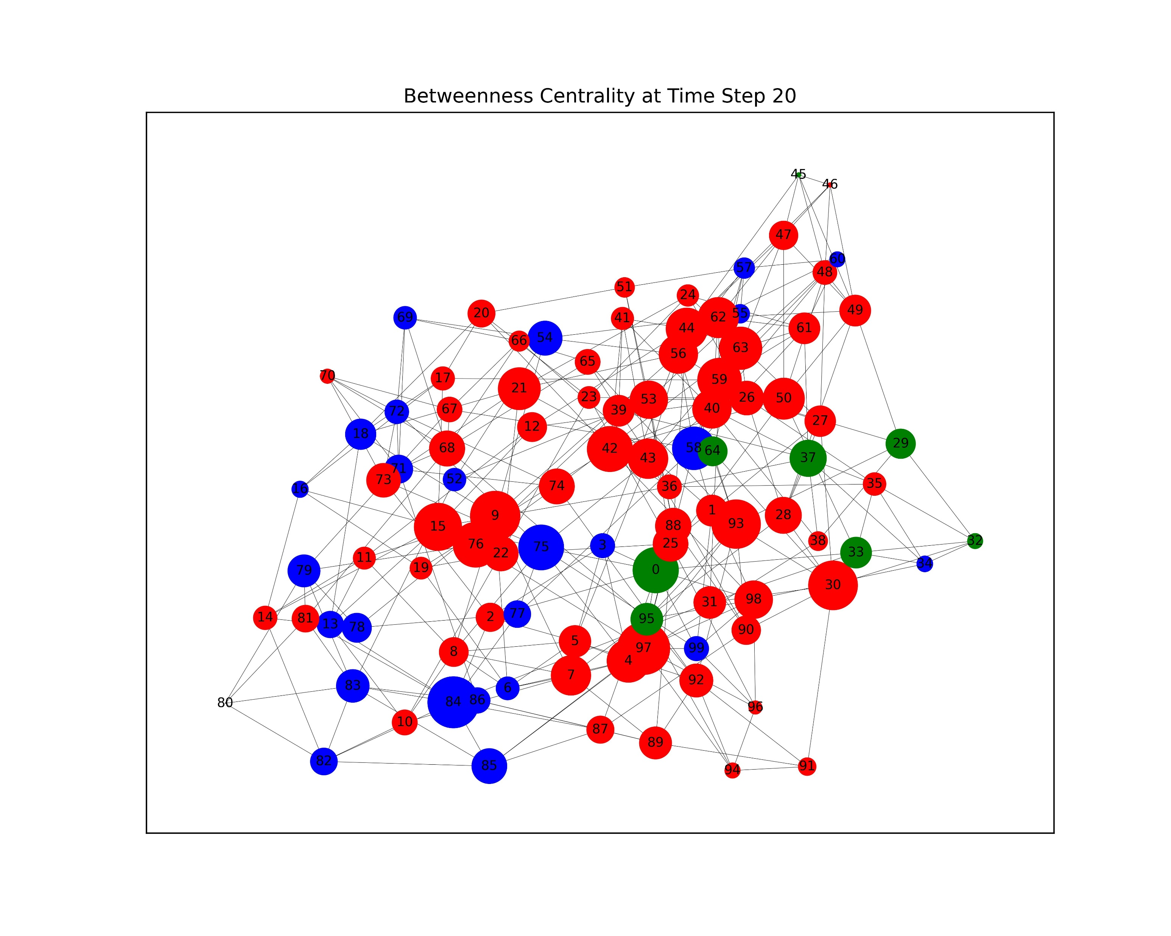

Point Centrality Measure
2. Betweenness Centrality
Betweenness centrality describes the frequencies of vertices/nodes in the shortest paths between indirectly connected vertices/nodes.
A node is considered to be central to the degree that it lies between other points on the geodesic.
In other words, if more nodes are connected via a node, then this node is more important in facilitating/spreading or it could falsify, distort or even block the transmission of information during this process.
If p and q are distinct nodes and are reachable, suppose that they are indifferent to facilitating the spread of the information among multiple geodesics.
Define δ_{pq}(v) is the number of shortest paths which pass through a vertex v from p to q and δ_{pq} is the number of the shortest paths from p to q
Then the potential of a node, v, to control/manipulate information between these two nodes(i.e p and q) is the probability that this node falls on a randomly selected geodesic connecting p and q.
This probability is equal to δ_{pq}(v)/δ_{pq} .
Given by the following equation:
$$C_{B}\left(v\right)=\frac{2}{\left(n−1\right)\left(n−2\right)}\sum_{p≠v≠q}{\frac{δ_{pq}\left(v\right)}{δ_{pq}}}$$

Slide 13

Point Centrality Measure
3. Closeness Centrality
Closeness centrality measures how close a node is to others in the network, which describes the efficiency of the spread of information from one node to the other.
A node, v, is central if information(e.g. about new technology) quickly reaches others from this node. This measure extends degree centrality by looking at neighbourhoods of all radii, a higher score indicates a lower centrality.
Given by the following equation,
$C_{c}\left(v\right)=\frac{n−1}{\sum_{u∈V\backslash v}{d\left(u,v\right)}} w$here $d\left(u,v\right)$ is the u-v geodesic.
The inversion in the equation is to deal with the fact that this distance can be infinite.

Slide 14
Network Analysis
We investigate the centrality of the whole network, instead of focusing on point-based centrality measures.
We introduce a concept of 'meta-centrality', which would consider all the centrality measures discussed above and in other literature. This allows us to better identify super-spreaders concerning the structure of the network. By identifying these super-spreaders, there is a better chance to 'control' the epidemic or the transmission of information.
A structural hole is a gap between two unconnected nodes. When these two unconnected nodes are connected by a third node, the bridging node usually has more information advantages and control advantages since it acts as a mediator between different nodes.
To proceed, this involves a 3-step algorithm termed the Cumulative Rank which are
Quantifying the local advantage of each node,
Quantifying the global advantages of each node and finally,
Identifying influential spreaders in the network, by combining node performances and global performances.
Experiments have shown that this Cumulative-Rank algorithm outperforms existing measures when tested on real-world social networks.

Slide 15

3. Generating Our Network

Slide 16
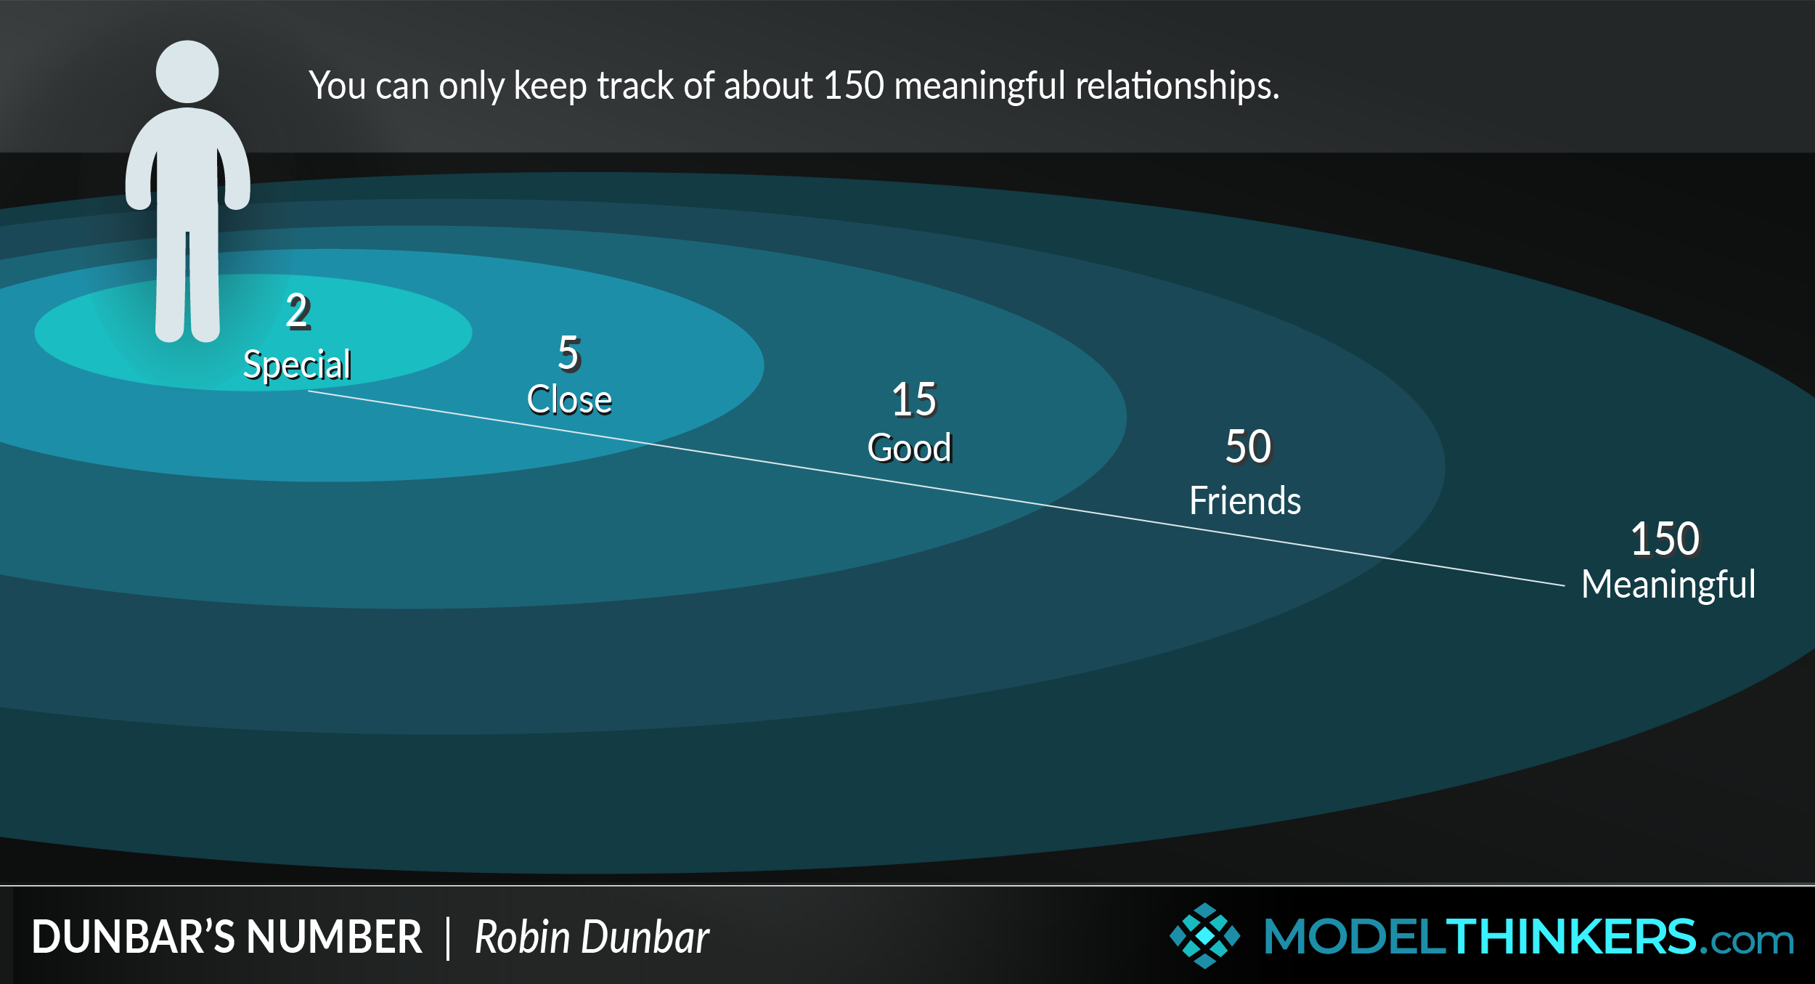
Dunbar’s Number
Dunbar’s number suggests humans maintain ~150 stable relationships, supported by studies of both online and offline human networks.
Relationships are divided into social circles: 5 (sympathy), 15 (affinity), 50 (active), and 150 (total).

Slide 17
The Configuration Model
Utilizes a scale-free graph model with a specified degree distribution.
A scale network has a degree distribution which follows a power law.
Random graph creation results in multi-edges and loops but can be ignored by choosing an appropriate distribution.
Advantages: allows us to set an exact degree distribution and has short path lengths.
Disadvantage: lower clustering than in real-world networks for large graphs.

Slide 18
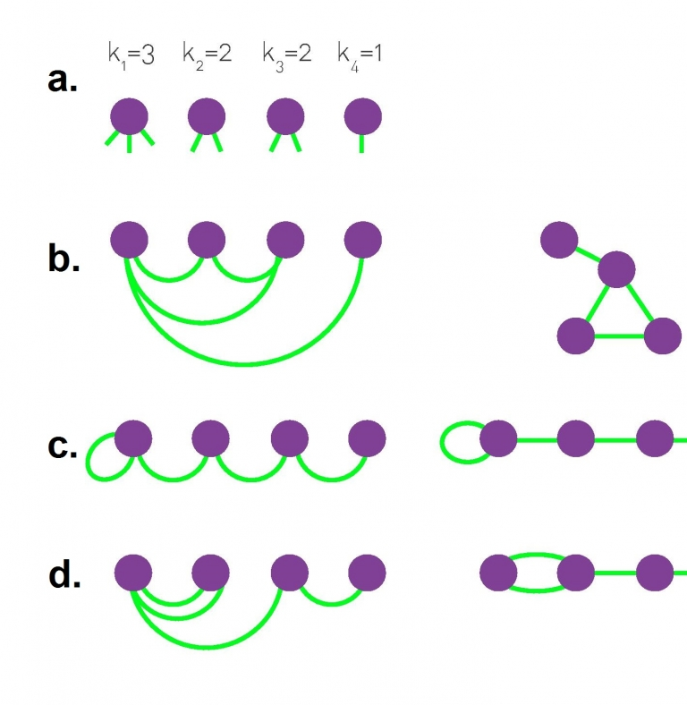
Creating the network
Nodes initialized based on network size, assigned random half edges using a N(150,625) distribution.
Half edges are categorized into social groups (A, B, C, D) using a 5:15:50:150 ratio.
The graph is formed by randomly selecting and joining pairs of half-edges within the same social group.
Edges weighted to simulate interaction strength and contact frequency.
Four normal distributions are used for daily, weekly, monthly, and yearly contacts. (corresponding to 4 social circles)
Weight represents units of time of contact per year
Each edge has its weight as the average of the nodes it joins.

Slide 19
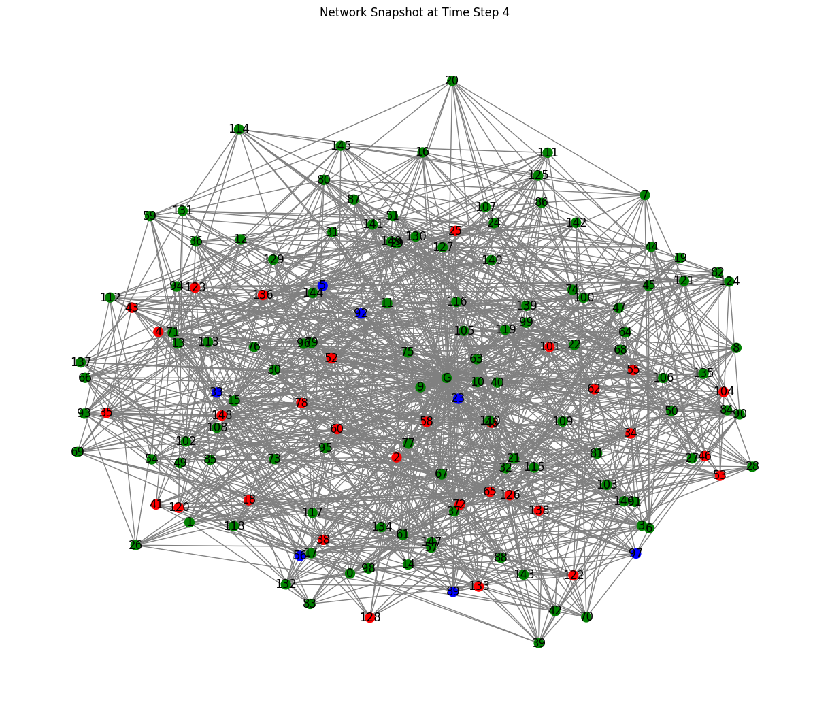
Random Contact
Need to model external interactions like social media, ads, and people outside our social network.
Added new vertex and connected to all nodes to create a ‘ghost edge’ for each node.
Used a Uniform U(1, 1500) distribution to weight the ‘ghost edges’
This simulates between 0 and 4 units of contact per day.

Slide 20
SIR on our Network

Slide 21
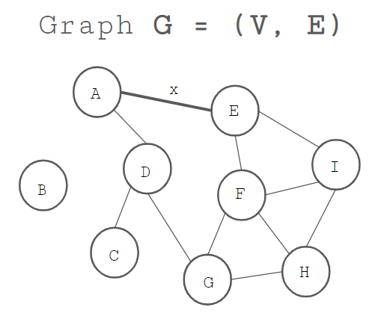
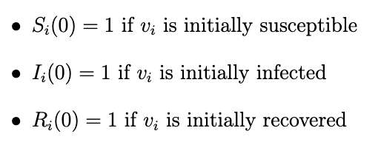
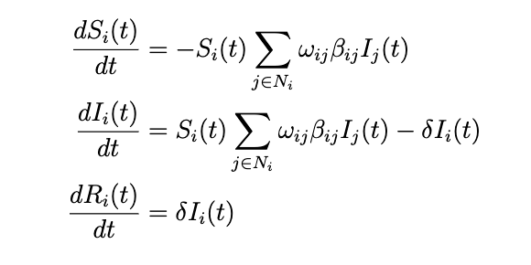
SIR on our Network
Define the graph structure
Define the initial conditions
Define the adapted SIR model

Slide 22
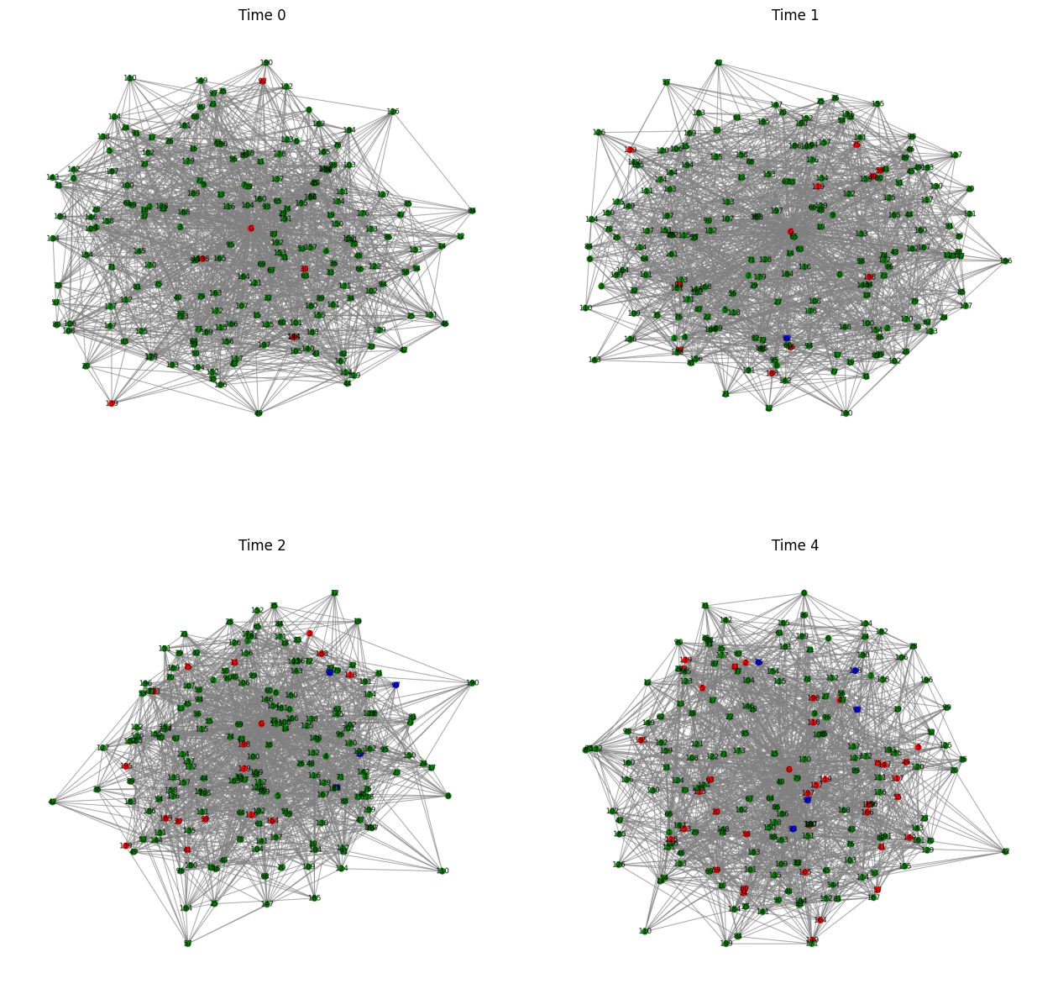
Time Snapshots
To analyze the robustness and reliability of the SIR model, we will leverage two methods:
Martingales: Model a fair game that helps in understanding the expected behaviour of the epidemic process. The conditional expected value of the next value in the process is equal to the current value given all prior information, so the expected value of the future state is fair and unbiased based on the current state.
Implementing Monte Carlo simulations: Monte Carlo allows us to understand the variability and uncertainty in the model by running the simulation multiple times and collecting statistics for the number of S, I and R over time.
blue is S, red is I and green is R

Slide 23
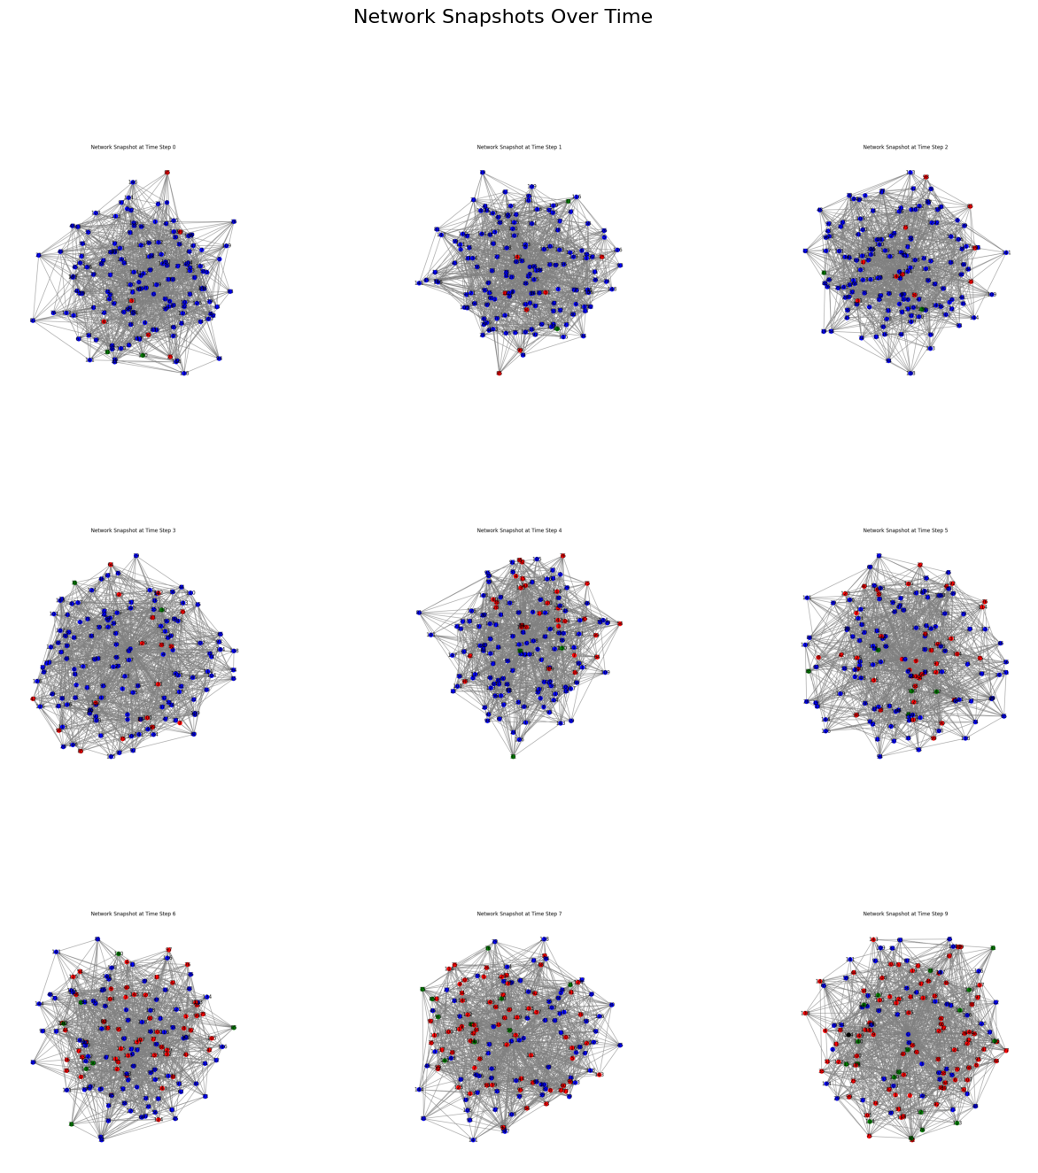
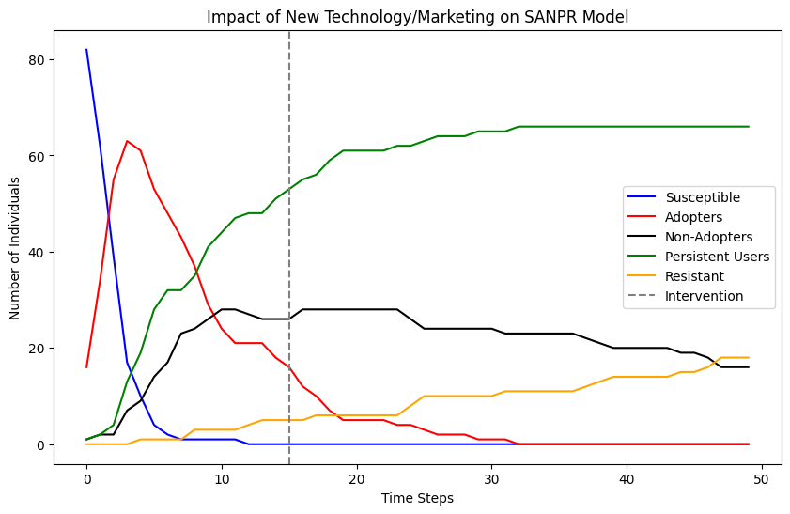
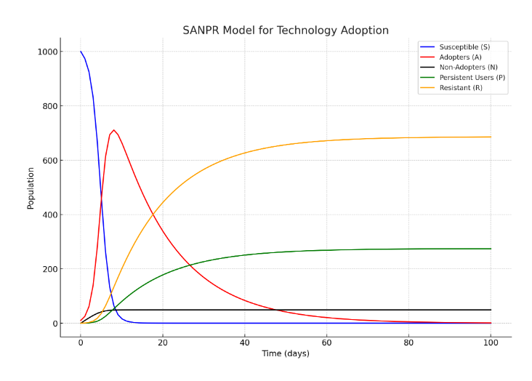
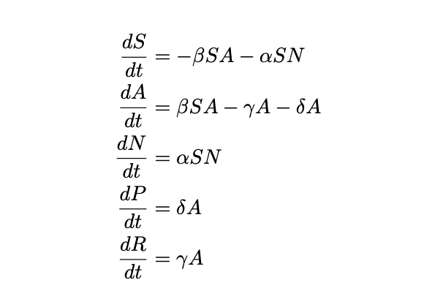
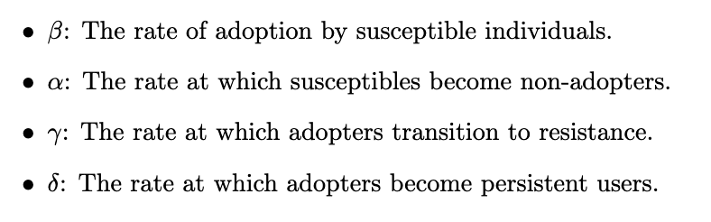
Adoption to Technology
Introducing new letters:
Susceptible (S): Individuals who are potential adopters of the technology.
Adopters (A): Individuals currently using the technology.
Non-Adopters (N): Individuals who choose not to adopt the technology at all.
Persistent Users (P}: Individuals who continue to use the technology without transitioning to resistance.
Resistant (R): Individuals who have adopted the technology but have since stopped using it or become immune to further adoption.
Deterministic SANPR
Stochastic SANPR

Slide 24
Conclusion
Introduce deterministic SIR and stochastic SIR
Introduce network and network centrality
Produce our network based on social behaviours
Adapt technology SIR model in our network.
THANK YOU!

